Slide 1



UNIT 1
LESSON 2
MONEY MATTERS
Part 5

Slide 2
Here are words related to the young business girls you read about in the article last time. Write the words out in full.
Then retell the story and include the given words.
business rubbish paper plastic glass recycling charge comeptition presentation Wise Pocket Products donate charity shelter
bsnss rbbsh ppr plstc glss rcclng chrg cmpttn prsnttn ws pckt prdcts dnt chrt shltr

Slide 3
Put the sentences into two groups.
I am studying hard for the biology test.
My neighbours are building a swimming pool.
What are you doing with that mobile phone?
Take the umbrella because it’s raining heavily.
I am studying hard for the biology test.
How often do you have your music lessons?
My parents don’t let me watch television after ten o’clock.
My neighbours are building a swimming pool.
What are you doing with that mobile phone?
Take the umbrella because it’s raining heavily.
Every summer we travel to the seaside to visit grandma and grandpa. People all over the world speak English.
How often do you have your music lessons?
My parents don’t let me watch television after ten o’clock.
Every summer we travel to the seaside to visit grandma and grandpa.
People all over the world speak English.

Slide 4
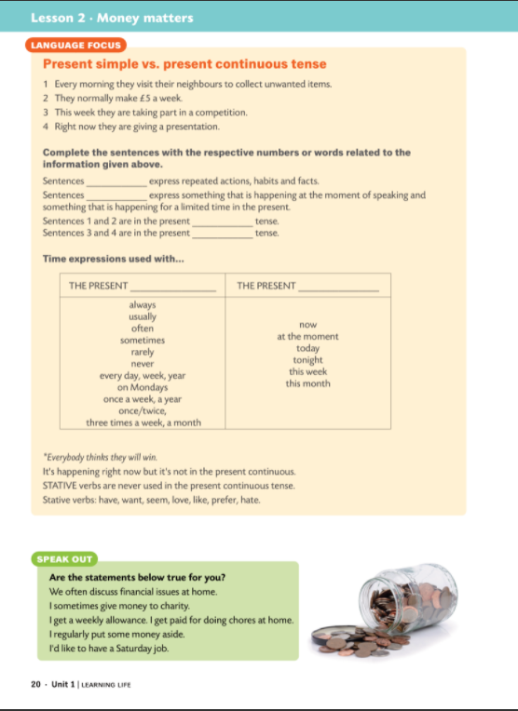
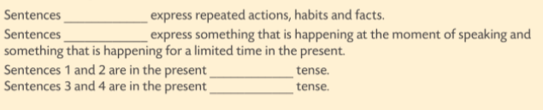

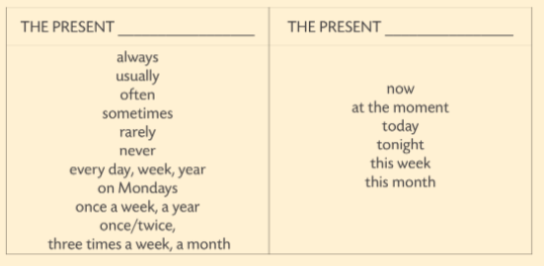
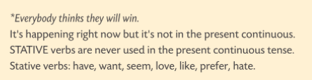
1 and 2
3 and 4
simple
continuous
SIMPLE
CONTINUOUS

Slide 5
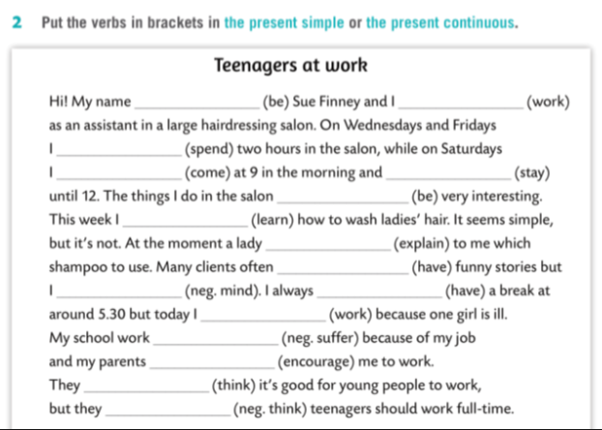
is
work
spend
come
stay
are
am learning
is explaining
have
don’t mind
have
am working
doesn’t suffer
encourage
think
don’t think

Slide 6
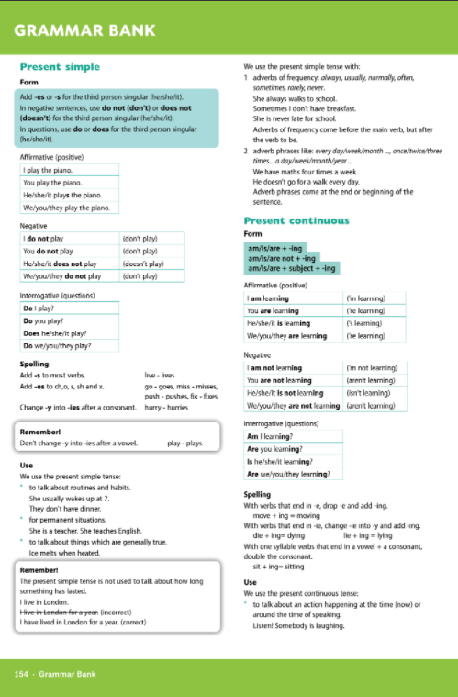
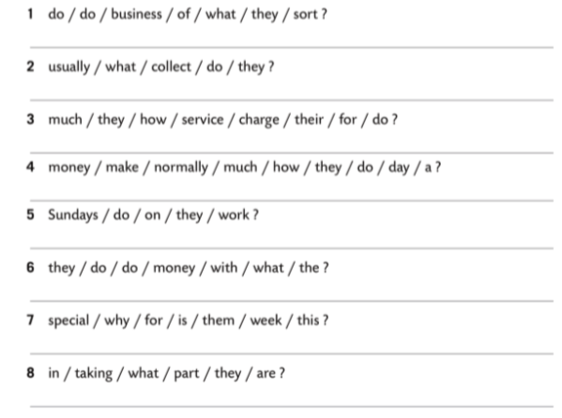

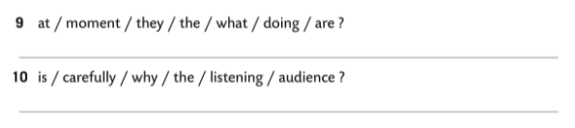
What sort of business do they do?
What do they usually collect?
How much do they charge for their service?
How much money do they normally make a day?
Do they work on Sundays?
What do they do with the money?
Why is this week special for them?
What are they taking part in?
What are they doing at the moment?
Why is the audience listening carefully?

